Slide 1
OpenCV 3.0
Speeding Up
Vadim Pisarevsky
Principal Engineer, Itseez

Slide 2
Speedup factors
T-API - GPU acceleration via OpenCL
Intel IPP subset (IPPCV) built into OpenCV
OpenCV HAL
and its universal intrinsics
cv::parallel_for_
other useful primitives & practices:
Matx, AutoBuffer, cvRound, ...

Slide 3
Transparent API (T-API) for GPU acceleration
done by contracts with AMD and Intel
single API entry for each function/algorithm – no specialized ocl::Canny, gpu::Canny etc.
no compile-time dependency of OpenCL SDK
minimal or no changes in user code
includes the following key components:
new data structure UMat
simple and robust mechanism for async processing
bonus: very convenient API for implementing custom OpenCL kernels

Slide 4
pre T-API: OCL module in 2.4
Separate API for each OpenCL-optimized function
The code will work only when OpenCL is there
Conversions Mat<=>oclMat are always explicit
#include "opencv2/opencv.hpp"
using namespace cv;
int main(int argc, char** argv)
{
Mat img, gray;
img = imread(argv[1], 1);
imshow("original", img);
cvtColor(img, gray, COLOR_BGR2GRAY);
GaussianBlur(gray, gray,
Size(7, 7), 1.5);
Canny(gray, gray, 0, 50);
imshow("edges", gray);
waitKey();
return 0;
}
#include "opencv2/opencv.hpp"
using namespace cv;
int main(int argc, char** argv)
{
Mat img = imread(argv[1], 1);
ocl::oclMat ocl_img(img), ocl_gray;
ocl::cvtColor(ocl_img, ocl_gray,
CV_BGR2GRAY);
ocl::GaussianBlur(ocl_gray, ocl_gray,
Size(7, 7), 1.5);
ocl::Canny(ocl_gray, ocl_gray, 0, 50);
Mat gray;
ocl_gray.download(gray);
imshow("edges", gray);
waitKey();
return 0;
}

Slide 5
T-API: UMat
UMat is new type of array that wraps clmem when OpenCL is available;
when OpenCL is not available, UMat is similar to Mat.
Replacing Mat with UMat is often the only change needed
#include "opencv2/opencv.hpp"
using namespace cv;
int main(int argc, char** argv)
{
Mat img, gray;
img = imread(argv[1], 1);
imshow("original", img);
cvtColor(img, gray, COLOR_BGR2GRAY);
GaussianBlur(gray, gray,
Size(7, 7), 1.5);
Canny(gray, gray, 0, 50);
imshow("edges", gray);
waitKey();
return 0;
}
#include "opencv2/opencv.hpp"
using namespace cv;
int main(int argc, char** argv)
{
UMat img, gray;
img = imread(argv[1]).
getUMat(ACCESS_READ);
imshow("original", img);
cvtColor(img, gray, COLOR_BGR2GRAY);
GaussianBlur(gray, gray,
Size(7, 7), 1.5);
Canny(gray, gray, 0, 50);
imshow("edges", gray);
waitKey();
return 0;
}

Slide 6
T-API: Data flow
InputArray, OutputArray, InputOutputArray
.getMat()
.getUMat()
.getUMat(access)
Mat
UMat
.getMat(access)
UMat::getMat() invokes clFinish().
zero-copy is used whenever possible
Mat.release(), UMat::release() (and the destructors) copy/unmap the data back if needed:
{ // custom processing of UMat
Mat temp = um.getMat(ACCESS_READ | ACCESS_WRITE);
putText(temp, “Hello”, Point(100, 100),
FONT_HERSHEY_SCRIPT_SIMPLEX, 2, Scalar::all(255), 5);
...
}

Slide 7
T-API: under the hood
bool _ocl_cvtColor(InputArray src, OutputArray dst, int code) {
static ocl::ProgramSource oclsrc(“//cvtcolor.cl source code\n …”);
UMat src_ocl = src.getUMat(), dst_ocl = dst.getUMat();
if (code == COLOR_BGR2GRAY) {
// get the kernel; kernel is compiled only once and cached
ocl::Kernel kernel(“bgr2gray”, oclsrc, <compile_flags>);
// pass 2 arrays to the kernel and run it
return kernel.args(src_ocl, dst_ocl).run(0, 0, false);
} else if(code == COLOR_BGR2YUV) { … }
return false; // OpenCL function does not have to support all modes
}
void _cpu_cvtColor(const Mat& src, Mat& dst, int code) { … }
// transparent API dispatcher function
void cvtColor(InputArray src, OutputArray dst, int code) {
dst.create(src.size(), …);
if (useOpenCL() && dst.isUMat() && _ocl_cvtColor(src, dst, code)) return;
// getMat() uses zero-copy if available; and with SVM it’s no op
Mat src_cpu = src.getMat();
Mat dst_cpu = dst.getMat();
_cpu_cvtColor(src_cpu, dst_cpu, code);
}
Notes:
Now what happens internally in each of those functions:
We hide and rename existing CPU version of the algorithm and the slightly reworked variant of OpenCL version. We add top-level public function that checks whether it’s possible and it makes sense to go with OpenCL branch, if yes, tries to use it. On success it exits, otherwise Mat’s are retrieved and passed to the CPU version.
Different code paths, different memory models.

Slide 8
T-API: execution model
CPU threads
…
…
ocl::Queue
ocl::Queue
ocl::Queue
…
ocl::Device
ocl::Device
ocl::Context
One queue and one OpenCL device per CPU thread
Different CPU threads can share a device, but use different queues.
OpenCL kernels are executed asynchronously
cv::ocl::finish() puts the barrier in the current CPU thread.
It’s rarely needed to call cv::ocl::finish() manually.

Slide 9
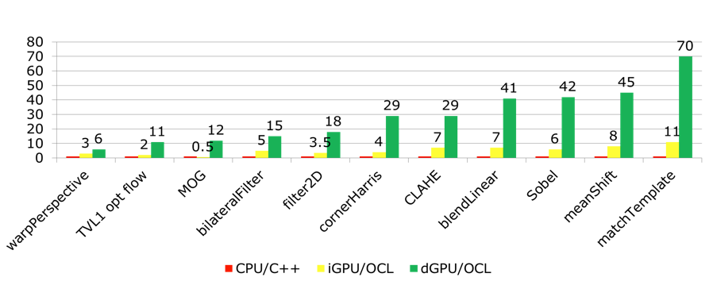
T-API coverage, performance
~100 functions covered:
image arithmetics, colorspace conversion, filtering, geometrical transformations, Canny, CLAHE, dense & sparse optical flow, face detection, HOG-based object detection, feature detection (ORB, FAST, GFTT), background subtraction, image stitching, image denoising (NLM)
CPU - AMD A10-6800k
iGPU - HD8670D
dGPU - Radeon HD7790

Slide 10
T-API: ready for prime time?
not quite:
OpenCL is not officially supported on any major mobile OS: iOS, Android, Windows Phone.
UMat+OpenCL win over Mat+CPU on large images and/or complex operations:
medianFilter - OpenCL wins CPU on FullHD or above.
dense optical flow (Farneback) - OpenCL is 3x faster on 480p.
results vary a lot depending on the particular CPU/GPU combination
We’ve tested all T-API optimizations, but the results are not identical to CPU (and sometimes not very close)
OpenCL drivers and HW constantly improve, but we observe instabilities from time to time (e.g. on unaligned data)
Do not replace all Mat’s with UMat’s yet!

Slide 11
T-API: Q&A
What if I pass UMat’s to cv::foo(), which is not OpenCL-optimized?
it will download/map inputs to CPU, process it there, then will upload/unmap the results to GPU.
What if OpenCL-optimized function is given some Mat’s and some UMat’s?
if output(s) are UMat’s, the function will use OpenCL branch. It will copy the inputs to GPU if needed.
What if the OpenCL branch fails to compile/run on particular hardware?
some error messages will be printed to stderr (in debug mode), the execution will fallback to the CPU path.
Can I write my custom OpenCL kernels and how to provide this runtime dispatching?
sure! use ocl::ProgramSource, ocl::Kernel etc. just like cvtColor.
call cv::useOpenCL() to check whether if you have OpenCL and it’s enabled.
How do I disable OpenCL?
compile-time: WITH_OPENCL=OFF
runtime: setUseOpenCL(false); - this is thread-local
Your questions on this part?

Slide 12
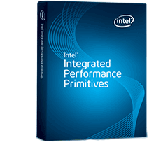

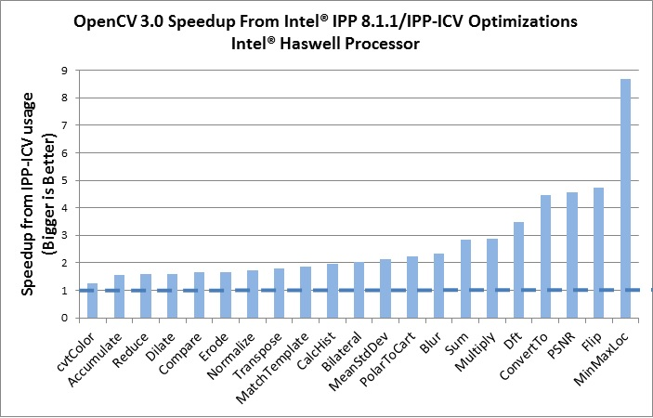
IPP + OpenCV = v. fast OpenCV
Intel gave us and our users free (as in “beer”) and royalty-free subset of IPP 8.x (IPPICV), several hundreds functions!
IPPICV is linked into OpenCV at compile stage and replaces the corresponding low-level C code (WITH_IPP=ON/OFF, ON by default)
Our buildbot ensures that all the tests pass

Slide 13
Generalizing IPP: OpenCV HAL
bindings, apps, samples
python, matlab, traincascade, facedetect, ...
opencv_contrib
face, text, rgbd, xobjdetect, ...
opencv
core, imgproc, objdetect, ...
possible, but not recommended
HAL
universal intrinsics (NEON/SSE), IPP, Eigen, ...

Slide 14
HAL in brief
present (3.0):
https://github.com/Itseez/opencv/tree/master/modules/hal/include/opencv2
static library, independent from opencv (no cv::Mat, etc.)
a part of OpenCV 3, open-source, same license
accessible from every opencv or opencv_contrib module
available to the users too, within libopencv_world.a, and separately from libopencv_world.so as “libopencv_hal.a etc.” (note “etc.”)
CPU-only (API-wise) - read: synchronous, system-memory, single-threaded?
~15 functions
future (3.x):
could be “augmented” using 3rd-party open-source or closed-source add-ons
strict conformance tests
100-500 functions

Slide 15
HAL: small overhead
[==========] Running 2 tests from 1 test case.
[----------] Global test environment set-up.
[----------] 2 tests from Core_HAL
[ RUN ] Core_HAL.mathfuncs
exp (N=100, f32): hal time=0.28usec, ocv time=0.39usec
exp (N=100, f64): hal time=0.36usec, ocv time=0.46usec
log (N=100, f32): hal time=0.23usec, ocv time=0.34usec
log (N=100, f64): hal time=0.46usec, ocv time=0.54usec
sqrt (N=100, f32): hal time=0.09usec, ocv time=0.18usec
sqrt (N=100, f64): hal time=0.26usec, ocv time=0.35usec
[ OK ] Core_HAL.mathfuncs (1 ms)
[ RUN ] Core_HAL.mat_decomp
LU (4 x 4, f32): hal time=0.18usec, ocv time=0.43usec
LU (4 x 4, f64): hal time=0.20usec, ocv time=0.43usec
LU (6 x 6, f32): hal time=0.37usec, ocv time=0.63usec
LU (6 x 6, f64): hal time=0.35usec, ocv time=0.60usec
LU (15 x 15, f32): hal time=2.27usec, ocv time=2.42usec
LU (15 x 15, f64): hal time=2.09usec, ocv time=2.51usec
Cholesky (4 x 4, f32): hal time=0.17usec, ocv time=0.40usec
Cholesky (4 x 4, f64): hal time=0.14usec, ocv time=0.38usec
Cholesky (6 x 6, f32): hal time=0.27usec, ocv time=0.53usec
Cholesky (6 x 6, f64): hal time=0.22usec, ocv time=0.47usec
Cholesky (15 x 15, f32): hal time=1.28usec, ocv time=1.67usec
Cholesky (15 x 15, f64): hal time=0.97usec, ocv time=1.40usec
[ OK ] Core_HAL.mat_decomp (0 ms)
cv::hal::exp(src.ptr<float>(),dst.ptr<float>(),
(int)src.total());
vs
cv::exp(src, dst);
cv::hal::LU(a.ptr<float>(), a.step, a.cols,
b.ptr<float>(), b.step, 1);
vs
cv::solve(a, b, x, DECOMP_LU);

Slide 16
HAL: increased modularity
Before:
cv::GaussianBlur() {
// opencl check ...
#ifdef HAVE_IPP
…
#elif HAVE_TEGRA
…
#endif
#if CV_SSE2
...
#elif CV_NEON
…
#endif
// c++ code
}
Eigen, OpenVX, fastcv,
Accelerate.framework
shaders?
custom dsp libs?
AVX?
MSA (MIPS)?
...
???
Want some modular solution!

Slide 17
HAL: increased modularity
After:
cv::GaussianBlur(…) {
// opencl check …
if(depth==CV_8U) cv::hal::GaussianBlur_8u(...);
else if ...
}
cv::hal::GaussianBlur_8u(...)
{
#ifdef cv_hal_GaussianBlur_8u
cv_hal_GaussianBlur_8u(...);
#else
// C++ implementation using universal intrinsics
#endif
}
opencv: cv::GaussianBlur, cv::ORB::compute, ..
opencv_hal: cv::hal::GaussianBlur
optional proprietary add-on: cv_hal_GaussianBlur_8u
building OpenCV with proprietary HAL add-on:
cmake … -D HAL_INCLUDE=<...> -D HAL_LIBS=<...>

Slide 18
HAL: universal intrinsics
128-bit SIMD engine with SSE2 and NEON backends, easy to extend to MSA (MIPS 5600)
Emulates missing intrinsics
Includes some complex intrinsics (to be extended)
Write and debug once (on desktop), run everywhere
Header-only implementation, in public HAL headers
NEON
Univ. Intrin
MSA
SSE
// a, b and c are 8-bit arrays
for( int i = 0; i < n; i++ )
c[i] = saturate_cast<uchar>(a[i] + b[i]);
// NEON:
for( int i = 0; i < n; i+=16 )
vst1q_u8(c + i, vqaddq_u8(vld1q_u8(a+i), vld1q_u8(b+i)));
#include “opencv2/hal.hpp”
for( int i = 0; i < n; i+=16 )
v_store(c + i, v_load(a+i) + v_load(b+i));
// SSE2:
for( int i = 0; i < n; i+=16 )
_mm_storeu_si128((__m128i*)(c + i),
_mm_adds_epu8(_mm_loadu_si128((const __m128i*)(a+i),
_mm_loadu_si128((const __m128i*)(b+i))));

Slide 19
Other useful tips (valid for OpenCV 2.4.x as well)

Slide 20
parallel_for_
several backends
GCD (OSX, iOS), OpenMP, Pthreads (new in 3.0), TBB, Concurrency (Windows, WinRT), C=
use cv::Mutex to implement map-reduce etc.
class MyLoopBody : public ParallelLoopBody
{
Public:
MyLoopBody(...) {}
void operator()(const Range& range) const { … } // process [range.start, range.end)
};
…
MyLoopBody invoker(...); // pass the external pointers, parameters here
#if 1
parallel_for_(Range(0, n), invoker[, nstripes]); // specifying proper nstripes can be crucial for good performance.
#else
invoker(Range(0, n)); // this is sequential branch for debug
#endif

Slide 21
alloca + malloc = AutoBuffer<>
~100x faster than malloc
Type-safe cross-platform alternative to alloca
The buffer is only valid within the function and the nested calls
using namespace cv;
void foo()
{
AutoBuffer<float> buf;
…
buf.allocate(n); // allocate buffer for n floats on stack or, if n is big, on the heap
float* bufptr = buf;
…
} // buf is invalid at this point
what’s the stack-or-heap threshold?
it’s automatically computed optional template parameter (~1Kb)
…
AutoBuffer<float, 100> buf(n); // allocate on stack if n<=100
…

Slide 22
Matx, Vec – lightweight alternatives to Mat
… if you know the type and size at compile-time
Matx<float, 4, 4> a(a00, a01, …, a32, a33); // specify matrix elements
float bdata[16] = { … };
Matx<float, 4, 4> b(bdata); // copy elements from array
Matx44f c; // Matx44f is a shortcut for Matx<float, 4, 4>
c = a*b; // this is ~5x faster than multiplication of cv::Mat’s in the 4x4 case
Mat m(a); // convert Matx<> => Mat
Matx44f a_copy(m.ptr<float>()) // convert Mat => Matx<> (continuous case)
If a function takes InputArray, it will likely accept Matx.
warpAffine(src, dst, Matx23d(alpha, -beta, dx, beta, alpha, dy), dst.size());
Vec<T, n> is derivative of Matx<T, n, 1>, as you would expect
Vec4f(a, b, c, d)*Vec4f(e, f, g, h); // quaternion product
// make image filled with green
Mat_<Vec3b> img(480, 640); img = Vec3b(0, 225, 0);

Slide 23
Misc
use cvRound, cvCeil, cvFloor, saturate_cast<T>() instead of round, floor, ceil, (int), etc.
cv::exp, cv::log, cv::pow are fast! (but cv::hal::exp etc. are even faster).
use matrix expressions with care, e.g. a=b+c+d creates a temporary matrix on each invocation. “a=b+c; a+=d;” does not. But complex Matx<> expressions do not imply extra penalty.

Slide 24
"We should forget about small efficiencies, say about 97% of the time: premature optimization is the root of all evil. Yet we should not pass up our opportunities in that critical 3%”
Donald Knuth
… especially when you are doing computer vision on a cell phone
OpenCV team
Questions?

